Slide 1
Predicting Kickstarter Project Success
UE24CS352A MACHINE LEARNING | MINI-PROJECT
Mithun S PES2UG24AM208
Raksha R Poojary PES2UG24AM214

Slide 2
Problem and data
Goal: predict whether a Kickstarter project reaches its funding goal, using only information known at launch.
199,233
Data: Five monthly Web Robots scrapes. Completed campaigns only, duplicates removed, goals converted to USD, post-launch fields excluded to avoid leakage.
projects after cleaning
63%
successful, 37% failed
70 / 30
split: 139,463 train, 59,770 test

Slide 3
Approach
17 features
Out-of-fold encoding
Three models
Goal, duration, name and blurb length, launch month and weekday, category, country and currency encodings, and a text score from Naive Bayes.
Target means and the text score are computed on held-out folds, so a project never sees its own label.
Logistic Regression, Random Forest and Gradient Boosting with balanced class weights, plus an ablation without the text feature.

Slide 4
Results on 59,770 test projects
Model | Accuracy | F1 | Precision (success) | Precision (failed) | Recall (success) | Recall (failed)
Random Forest | 0.787 | 0.823 | 0.869 | 0.678 | 0.782 | 0.795
Gradient Boosting | 0.787 | 0.822 | 0.874 | 0.675 | 0.776 | 0.806
Logistic Regression | 0.778 | 0.816 | 0.860 | 0.669 | 0.777 | 0.780
Gradient Boosting, no text feature | 0.773 | 0.809 | 0.869 | 0.655 | 0.756 | 0.802
Random Forest and Gradient Boosting tie at 0.787 accuracy. The text feature adds about 1.4 points for Gradient Boosting.

Slide 5
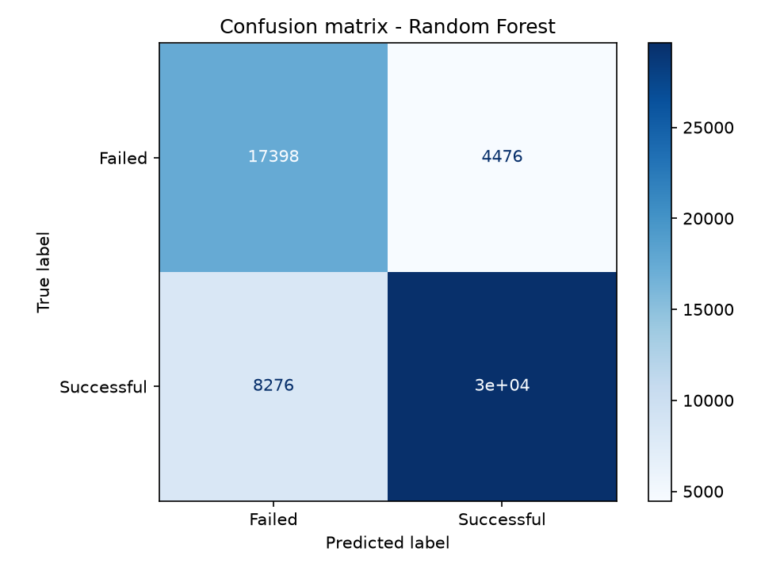
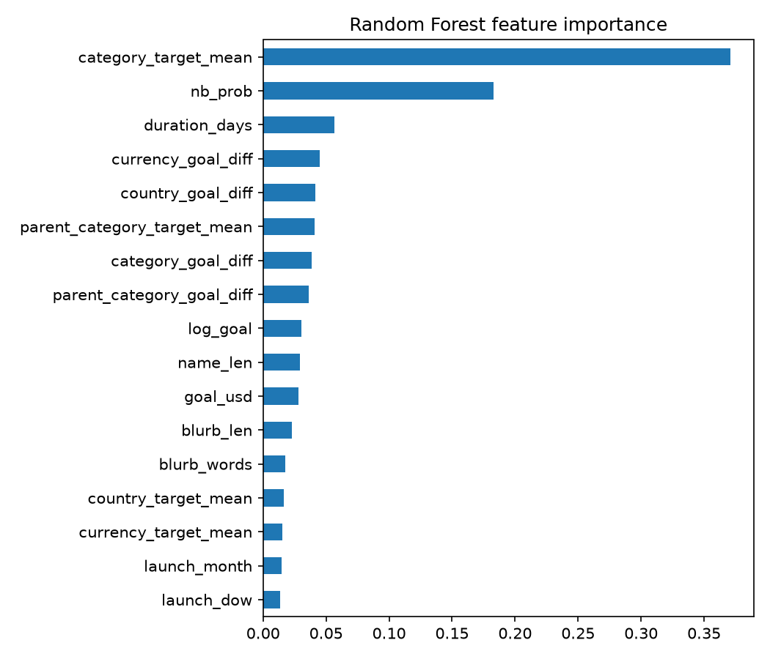
Confusion matrix and feature importance
17,398 failed and 29,620 successful projects predicted correctly; 4,476 and 8,276 missed.
Category success rate and the text score matter most.

Slide 6
Implementation and live demo
data.py
features.py
Loads, cleans and de-duplicates the CSVs
Builds the 17 leakage-safe features
train.py
app.py
Trains, evaluates and saves the best model
Streamlit app for the live demo
Live demo: enter a project's name, blurb, goal, duration and category to get its predicted probability of success.

Slide 7
Conclusions
Random Forest and Gradient Boosting are best: 0.787 accuracy, F1 about 0.82.
Category success rate and the name and blurb text score are the strongest features.
The text feature adds a small gain: accuracy 0.773 to 0.787 for Gradient Boosting.
Failed projects are harder to identify: precision is about 0.68.
Future work: tuning with cross-validation, BERT text features, image features.

